Slide 1
Social Media Usage & Emotional Wellbeing
Exploring how online behavior relates to emotional states
Presented by: Ayse Kocyigit

Slide 2
Project Overview
Analysis of a dataset on social media usage and emotional states
Goal: Understand how platform choice, time spent and activity levels relate to emotional wellbeing
Strategy:
Define Research Goal
Data Cleaning
EDA (Univariate & Bivariate)
SQL Analysis
Notes:
"This project is about exploring the connection between how people use social media and how they feel.
The dataset includes information about the platforms people use, how much time they spend online, how active they are, and their dominant emotional state.
My goal was to see if patterns emerge — do some platforms make people happier than others? Does spending more time online make people feel better or worse? And is being active online linked to positive emotions?
This matters because social media is a huge part of modern life, and understanding its effects can help people make healthier choices."

Slide 3
Data Cleaning
Removed rows with missing values
Corrected invalid age entries (e.g., “Male instead of a number”)
Set User_ID as index, no duplicates found
Result: Clean, reliable dataset ready for analysis
Notes:
"Before diving into the analysis, I cleaned the data to make sure the results would be accurate.
I removed the few rows with missing values, which in this case was only one row, so it didn’t affect the dataset much.
I also fixed invalid entries in the age column — for example, some cells contained words like 'Male' instead of a number.
I set the user ID as the index so each person was uniquely identified, and I confirmed there were no duplicate rows.
At the end of this process, the dataset was clean and ready for analysis."

Slide 4
Analysis
Emotions by platform
Usage time vs. emotion
Activity Levels vs. Emotion
Notes:
"I approached the analysis in three main parts.
First, I looked at how emotions vary depending on the platform people use.
Second, I compared daily usage time with emotions to see if more time online is linked to feeling better or worse.
Third, I compared activity levels — such as posting, liking, and messaging — to emotions, to see if more interaction correlates with more positive feelings."

Slide 5
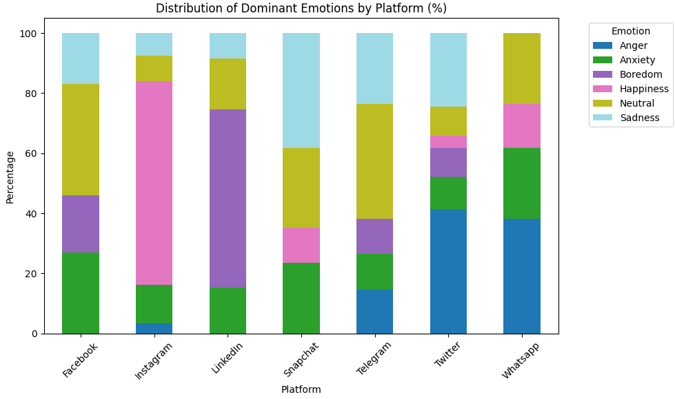
Emotions by Platform
Instagram users report more happiness
Twitter and Facebook show higher levels of anxiety or neutral emotions
Possible reason: different platform culture and content types
Notes:
"When comparing emotions by platform, I noticed a clear difference. Instagram users had higher levels of reported happiness. Facebook and Twitter, on the other hand, had more users reporting anxiety or neutral feelings.
This could be linked to the culture of each platform — Instagram is more visual and often focuses on curated, positive content, while Twitter and Facebook tend to have more debates, news, and text-heavy interactions."

Slide 6
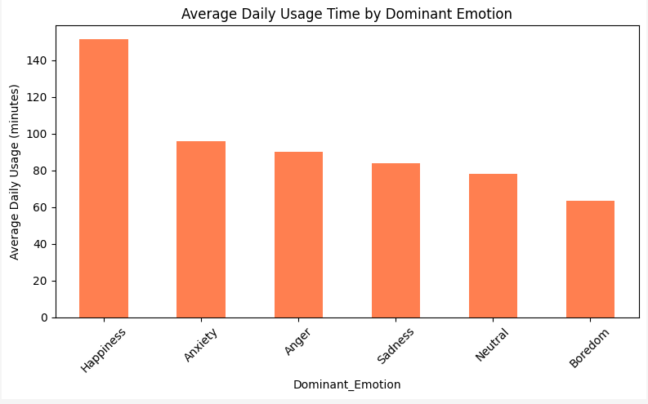
Usage Time vs. Emotion
Negative emotions linked to longer daily usage
Anxiety and sadness have the highest usage time
Possible reason: emotional states influencing usage, or overuse impacting mood
Notes:
"When I compared daily usage time with emotions, I saw that users who reported negative emotions — like anxiety or sadness — were spending more time online.
This could mean that people who aren’t feeling well turn to social media as a coping mechanism. Or it could mean that spending too much time online is contributing to those negative feelings.
The data doesn’t prove cause and effect, but the pattern is clear."

Slide 7
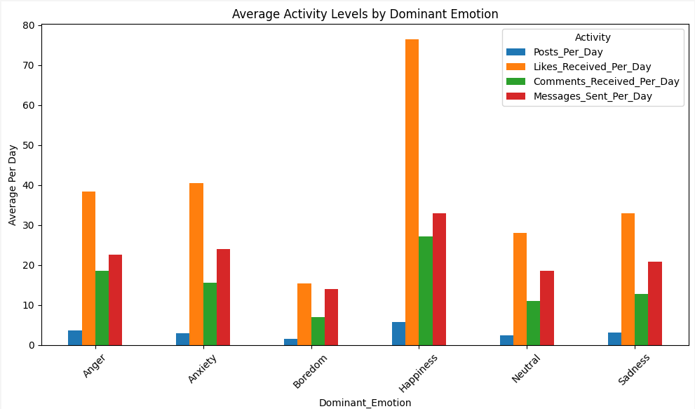
Activity Levels vs. Emotion
Happy users are the most active: more posts, likes, and messages
Sad or bored users engage less
Suggests that active interaction supports positive feeling
Notes:
"When I looked at activity levels, the difference was striking. Happy users were posting more often, liking more content, and sending more messages.
People who felt bored or sad were much less active — they might be scrolling passively instead of engaging.
This suggests that active participation in social media might be linked to better emotional wellbeing, while passive use might not have the same benefit."

Slide 8
Challenges and Learnings
Choosing the right dataset and committing to research area
Data cleaning is just as important as analysis
Visualizations reveal patterns not visible in raw data
Notes:
"One of the main challenges was dealing with inconsistent values, especially in the age column. It showed me how crucial data cleaning is — even one invalid entry can break your analysis.
Another key learning was that visualizations are essential. Some patterns, like platform differences in emotions, would be very hard to spot by just looking at numbers in a table."

Slide 9
Social Media Usage & Emotional Wellbeing
Exploring how online behavior relates to emotional states
Presented by: Ayse Kocyigit
Notes:
"To sum up: the choice of platform seems to affect emotional states, with Instagram showing higher happiness levels than others.
Spending more time on social media doesn’t necessarily make people happier — in fact, it was often linked to negative emotions.
And finally, active interaction — posting, liking, and messaging — is linked to feeling better, while passive scrolling seems to be less beneficial."
"That’s the end of my presentation. Thank you for listening, and I’m happy to answer any questions."

